Slide 1
Jeans in our days
Susán Hanna
Neumann János Középiskola és Kollégium
9. évfolyam

Slide 2
The Company
The Style
Innovations
The Origin of Denim

Slide 3
How were the first Jeans born?
What is the best selling jeans brand in the world?
Recent style of jeans
Other innovations

Slide 4
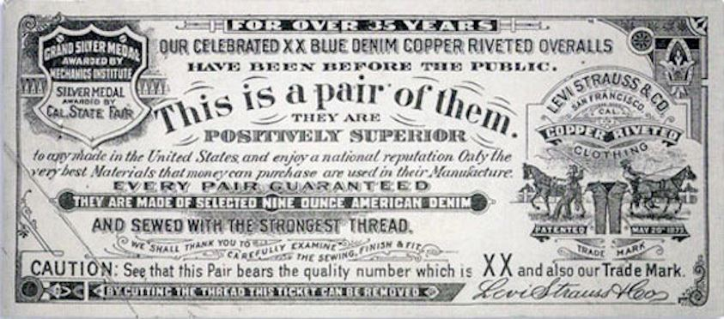
How were the first Jeans born?
Levi Strauss was selling canvas to the gold miners when one day a man came up to him. He said he couldn’t find trousers that were strong enough for the work.
Levi decided to make trousers for them, which at the beginning were almost white and they tore easily. To satisfy them, he painted it blue and started to use metal rivets. That is how the first blue jeans were born.

Slide 5
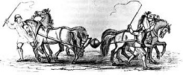
What is the best selling jeans brand in the world?
As the years went by, Levi’s jeans became more and more popular. Both miners and cowboys liked them and they grew into the classic American working trousers. It didn’t take much time for other American firms to explore this item and make their own brand and after the Second World War it spread all over the world.
However, the authentic Levi’s is still the best-selling jeans in the world. Its logo was made after the famous magdeburg experiment.

Slide 6
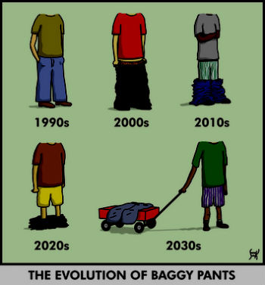
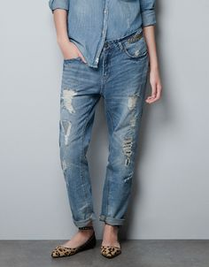
Recent style of jeans
Baggy Jeans: These jeans can be noticed by their very wide and straight leg. This style may seem to be new, however, it is about a hundred years old. At the beginning of the 20th century workers needed this style and it was brought back by the skaters in the 80’s. Nowadays they are worn falling on the hip and the underpants can also be seen.
So-called boyfriend jeans are becoming fashionable now. They also have straight leg but their waist is higher and their crotch is not as big as that of baggy jeans.

Slide 7
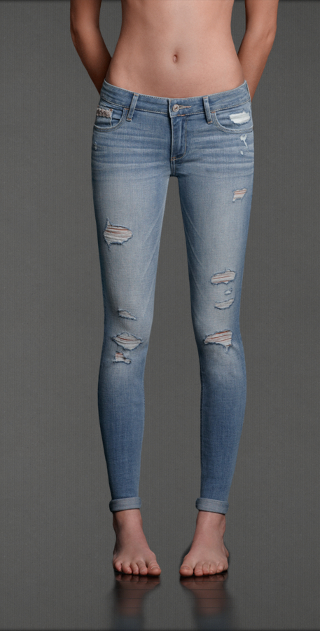
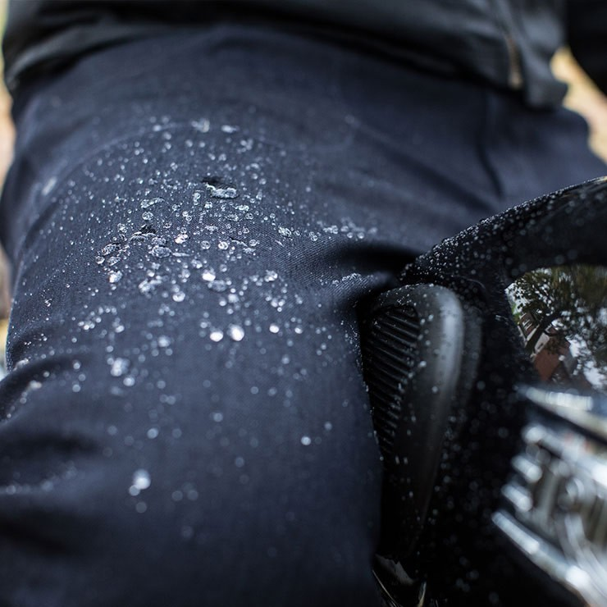
Furthermore, jeans have several other types. From wide leg baggy jeans to tight, so-called skinny jeans. The material of skinny jeans is also an innovation, as they are more elastic. In addition there are even jeans with a waterproof layer on them.
Jeggings, which are the cross between jeans and leggings, are also a new trend. However their appearance is the same as a skinny jeans’.

Slide 8
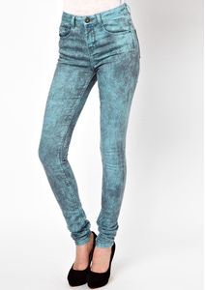
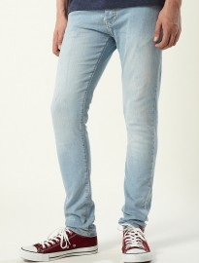
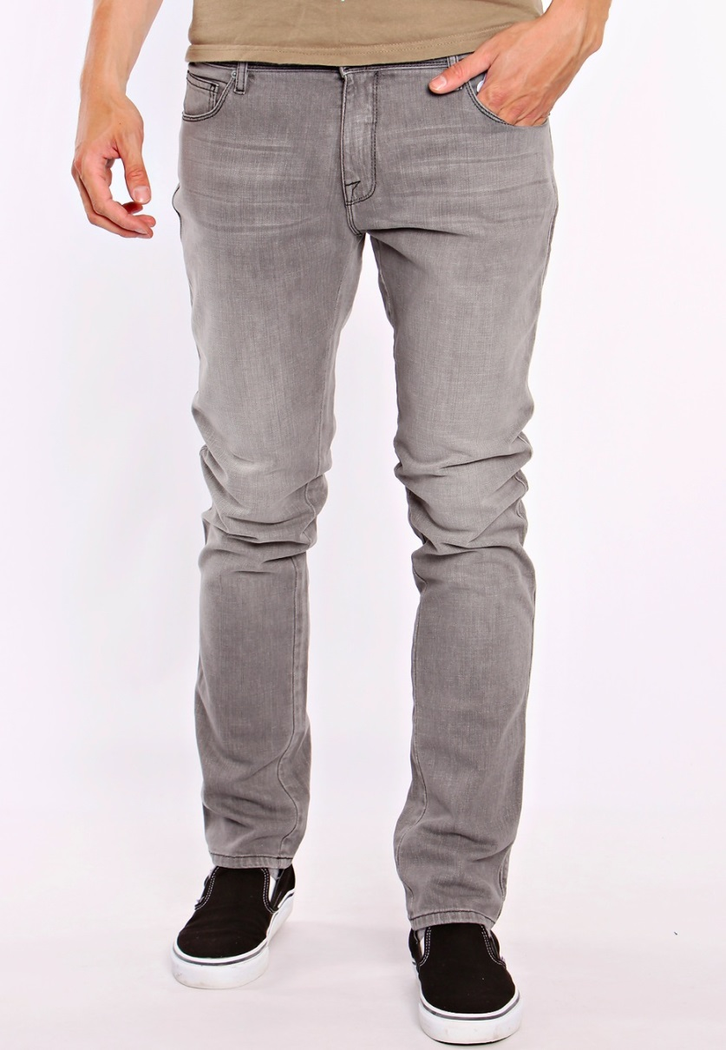
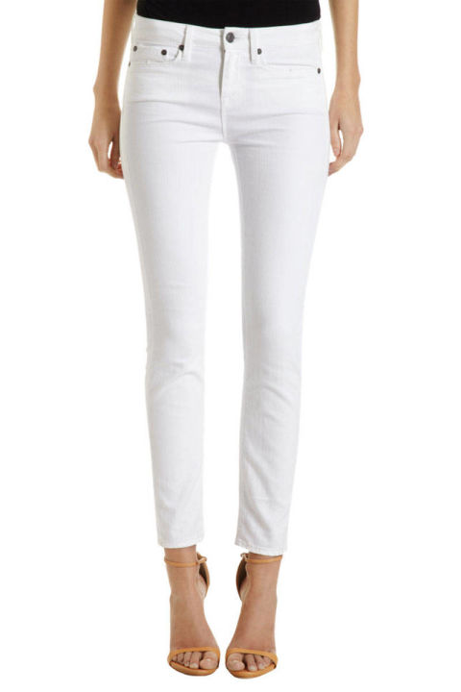
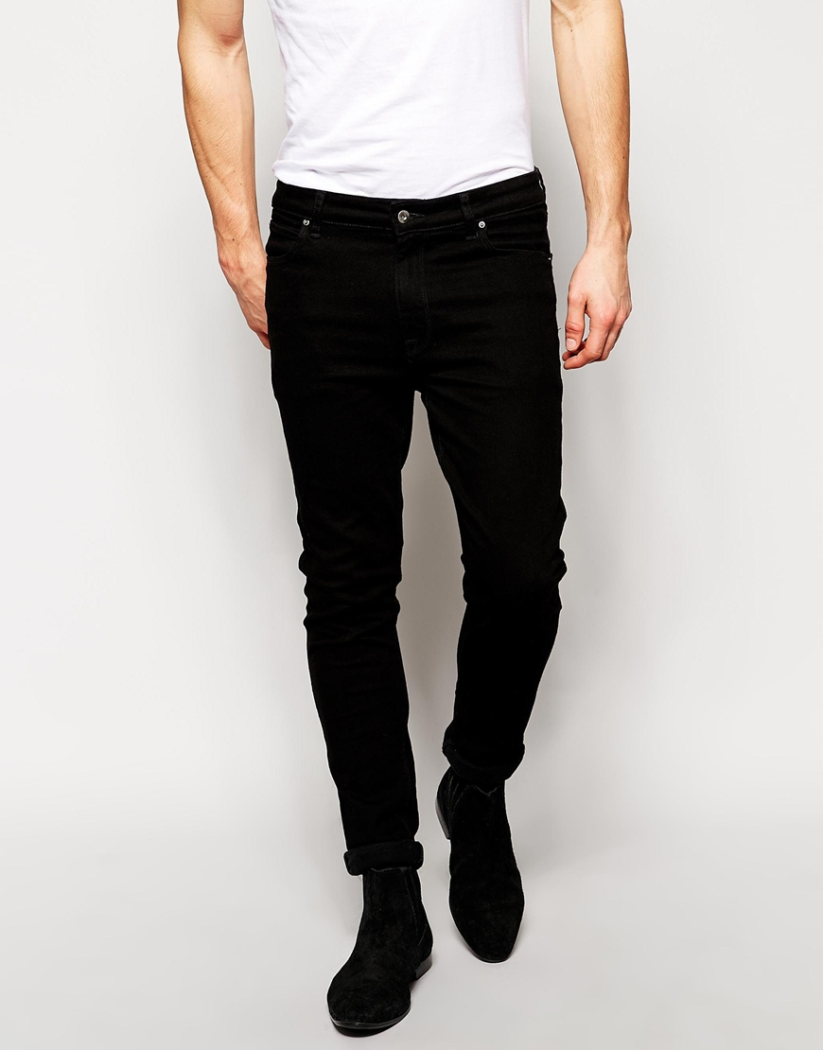
Other innovations
The original colour of serge de Nimes was almost white. Levi painted it dark blue and the original jeans are still blue. However, nowadays other colours are also available. You can buy jeans in grey, marble, white, black and different shades of blue.
2016.03.30.
8

Slide 9
To sum up, Blue Jeans are considered to be the most popular item among people. It does not matter whether they are teenagers, students, workers or diplomats.
Jeans will never go out of fashion and they have so many varieties that everyone can choose the most suitable one.

Slide 10
Tank you for your time and attention!

