Slide 1
Jeans in our days
“Fashion changes, but style endures.”
― Coco Chanel

Slide 2
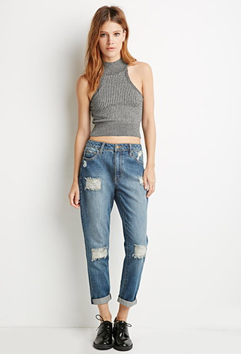
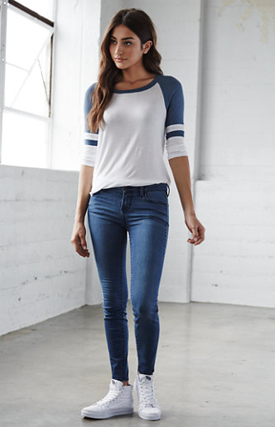
Types of jeans

Slide 3
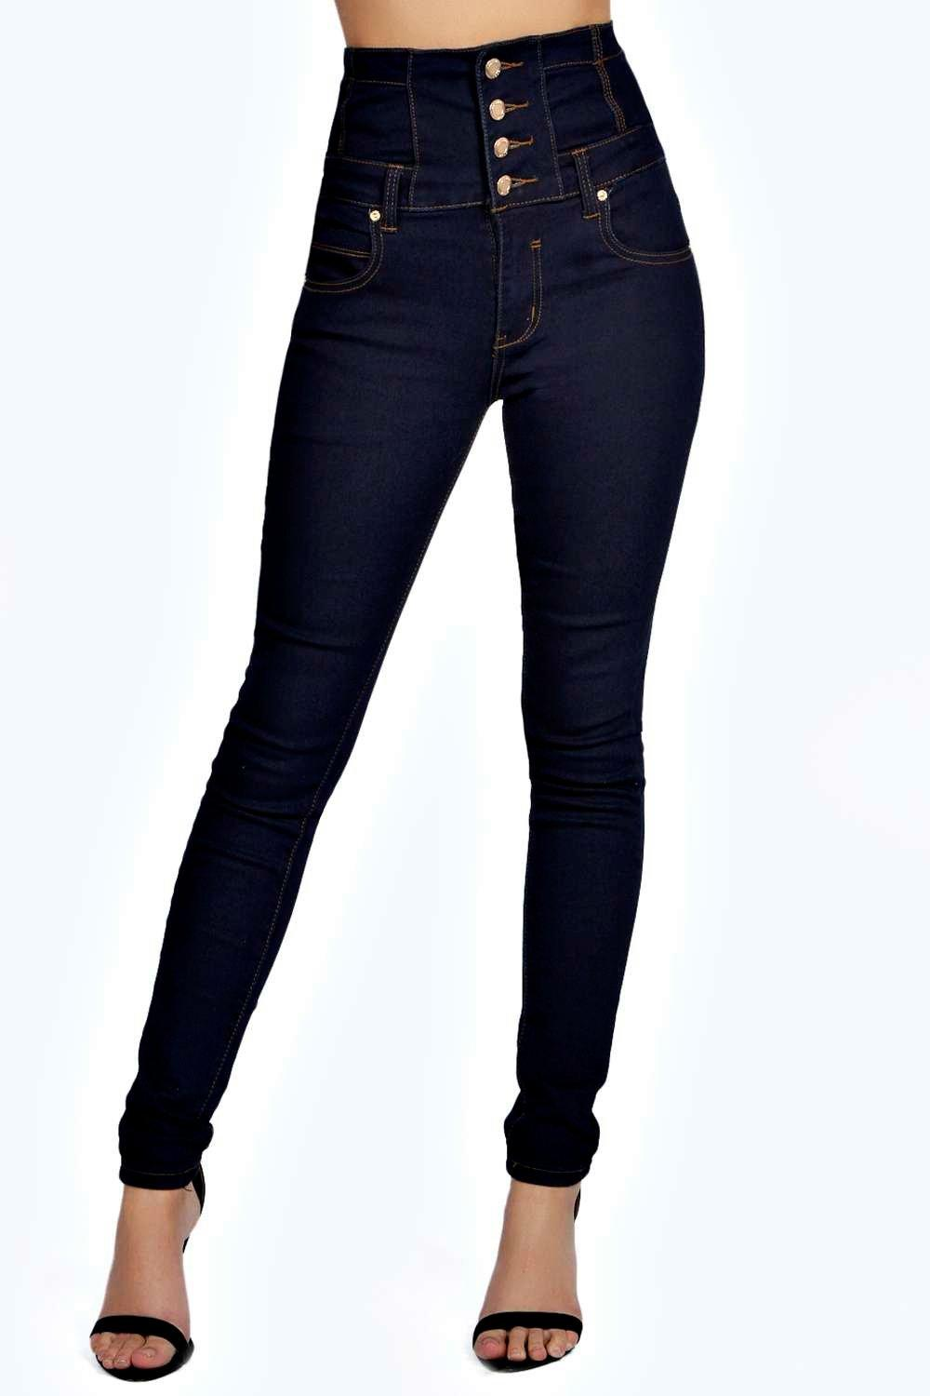
High Waisted Jeans
-they go up to the waist
-perfect jeans for wearing cropped tops
-they make legs appear longer

Slide 4
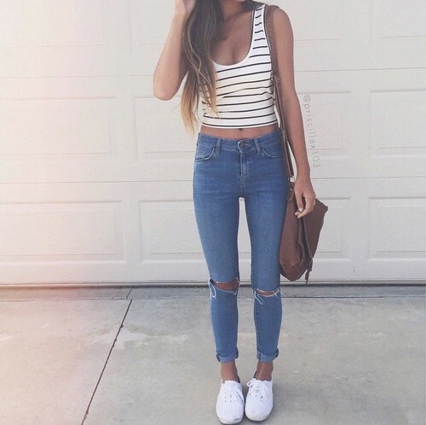
Skinny Jeans
- tight
-they get slimmer at the ankles
-made out of stretchy material

Slide 5
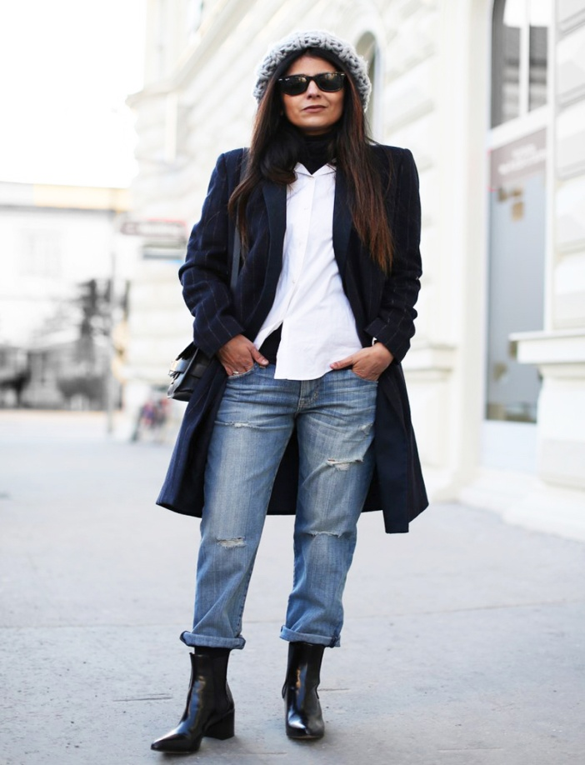
Boyfriend Jeans
-loose and baggy
-but they get slimmer at the ankles
-gives a really casual look

Slide 6
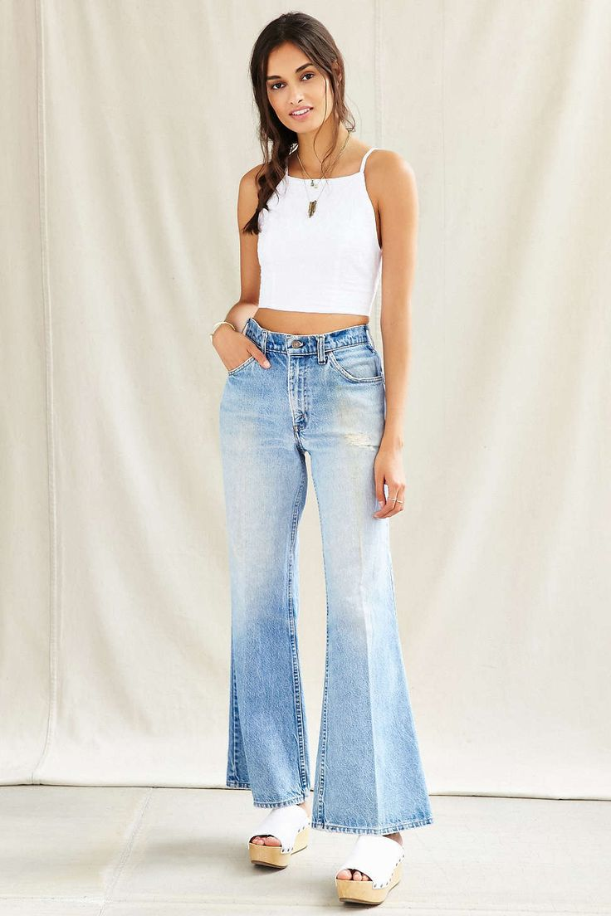
Flare Jeans
-originated in the 70's
-they get baggy at the bottom
-they give a hippie,chilled look

Slide 7
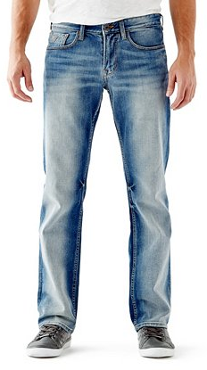
Straight leg jeans
-they go straight to the ankles
-perfect and comfortable to work
- Men wear them most of the time

Slide 8
Thanks for watching!
I got information and images from: - Pintrest
- Google Pictures
- Urban Dictionary

